Slide 1




HR Buddy:AI-Powered HR Assistant
BY
z-index-999

Slide 2
TEAM MEMBERS
AASIF KHAN A (24MIS1075)
HARINAATH B(24MIS1084)
NIRMAL P(24MIS1025)
SWOT

Slide 3
Conversational AI-powered self-service portal for quick HR query resolution.
Automated leave management with rule-based approval and balance validation.
IDEA/ SOLUTION
Onboarding & asset issuance workflows streamlined through automation.
Integrated SSO & HRIS connectivity for secure and unified employee access.
Policy knowledge base integration enabling instant, reliable policy-related answers.

Slide 4




PROBLEM RESOLUTION
AI-driven conversational interface ensures employees get instant, accurate responses without waiting for HR intervention.
Automated lifecycle workflows eliminate delays in leave approvals and onboarding, reducing SLA breaches significantly.
Centralized policy knowledge base provides quick, reliable access to HR policies, boosting employee satisfaction.

Slide 5

Unique Value Propositions (UVP):
AI-powered Conversational Support for instant and seamless HR query resolution.
Automated Lifecycle Workflows reduce manual intervention and approval delays
Single Sign-On (SSO) Integration ensures secure, unified employee access.
Static Data Simulation enables workflow automation without live system dependency.
Centralized Policy Knowledge Base enhances employee satisfaction with quick answers.

Slide 6

Technical Approach
Algorithm Development
Application Development:
Integration & Security:
Workflow Automation:
Cloud & Database Services:
Natural Language Processing (NLP) with Dialogflow / Rasa / OpenAI API for building the conversational AI interface.
React.js (frontend) and Node.js/Express.js (backend) for creating the self-service HR portal with smooth UI/UX.
SSO & HRIS API integration (Workday, HRNet, Paylocity) ensuring secure access and centralized data flow.
Static data–driven automation for leave approval and asset issuance to demonstrate lifecycle management.
MySQL / PostgreSQL for structured employee data storage and REST APIs for scalable, high-performance communication.

Slide 7
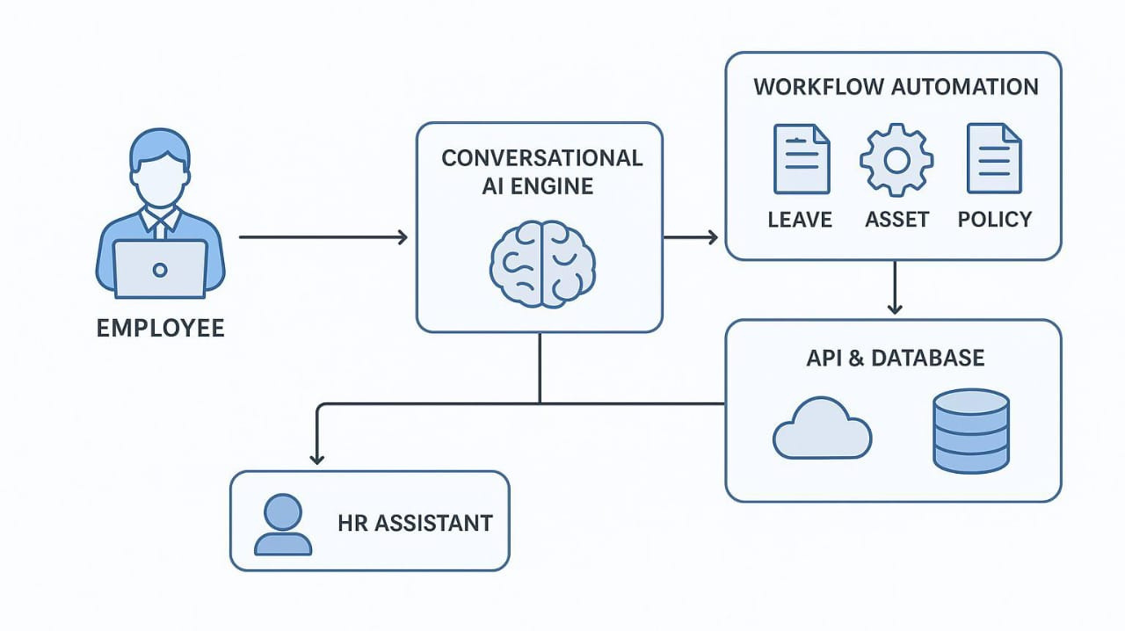
Process Flow Architecture
Product Status:
30% of the product has been successfully built, with core modules for conversational AI and workflow automation in place. Integration and testing phases are scheduled for upcoming iterations.

Slide 8

Analysis of Feasibility:
Technical: NLP + AI Chatbots + HRIS API integration.
Financial: Cost-effective, improves ROI
Market: High demand for HR automation
Operational: 24/7 support, scalable, reduces workload
Feasibility & Viability
Challenges & Risks:
Technical: Data security, system integration
Financial: High initial cost
Market: Adoption & trust issues
Operational: Staff resistance, uptime dependency
Strategies to Overcome:
Methods: Encryption, role-based access
Principle: Agile, iterative model
Strategies: Training + phased rollout
Algorithms: NLP, sentiment analysis, predictive AI

Slide 9


Potential impact on the target audience
Positive
Reduced dependency on HR staff for routine tasks
Improved employee satisfaction & engagement
Better compliance with policies & processes
Negative
Initial cost of AI implementation
Data security & privacy concerns
Need for change management & training
IMPACT
AND
BENEFITS

Slide 10


Social – Improved accessibility for employees, transparent communication, higher trust in HR processes
Economic – Reduction in HR operational costs, improved productivity, faster turnaround in HR services
Organizational – Efficient onboarding & exits, reduced SLA breaches, scalable HR operations
Environmental (Indirect) – Less paperwork through digital workflows, reduced waste
Benefits of the solution

Slide 11

Research & References
Strategic Plan
1. On AI in Human Resource Management (HRM)
Olan et al. (2024) provide a comprehensive review of how AI technologies are reshaping HR.
They cover recruitment, employee engagement, training, and performance evaluation.
The paper also sets a research agenda, highlighting gaps and future directions in AI-HRM.
Why useful? It gives you a strong theoretical foundation to show how AI fits into the HR domain overall.
2. On AI-Powered Chatbots & Conversational UI
Casadei et al. (2023) focus on chatbots used in Robotic Process Automation (RPA).
They examine how employees perceive trust, usability, and satisfaction when interacting with conversational interfaces.
Why useful? Supports the chatbot UI feature of your prototype, showing real-world benefits and user acceptance challenges.

